Slide 1

GenevaERS Annual Review Transforming GenevaERS to Java
By the GenevaERS Team
October 23, 2025

Slide 2
Last Year’s OMP Presentation
z/OS Environment
We demonstrated our use of:
z/OS environment
Multi-threading
Multi-language
With JVM started only once
Primarily focused on Run-time Efficiency
Results of Efforts
Multiple levels of interfacing possible
Data transmission between applications is possible
Use of jzos is integral to success of the efforts
Although of course ASM-Java was less efficient than just ASM, the overhead was surprisingly low
Area of further research includes performance implications of ASCII to EBCDIC conversion processes for a high-performance engine like GenevaERS
Multi-Threaded Java Daemon
(Main Task)
Java Thread to start 3GL application
Java
Thread to create thread pool
Needed
Thread
Count
3GL/ASM main program
Dynamically Loaded User Written Java Classes with Methods
Subtask
Thread
Subtask
Thread
Subtask
Method
Calls
Thread

Slide 3
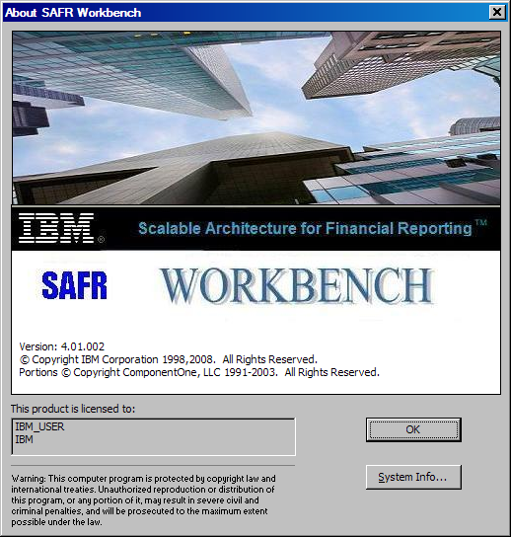
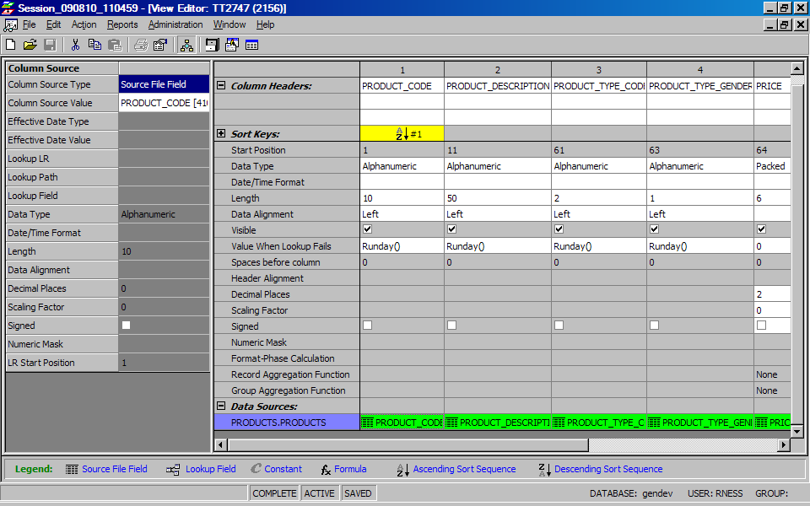
What GenevaERS Is
What is GenevaERS
Services asset composed of 100k lines of z/OS assembler code, Java, and Eclipse
Generates highly efficient machine code for tremendous scalability
Can be used to simply ETL processes all the way to a platform for developing a complex financial and reporting application
Created for reporting processes for world’s the largest financial organization
What it is Not
A database or database centric technology
An end-user query tool
What it Does
Closes the financial books of record on a daily basis – no other application in the marketplace can do this
What are the Business Benefits
Allows data analysis at very low levels of detail
And of many more attributes – product; geography; channels
With greater history
Supporting many more financial, regulatory, management and even risk related analysis
Which all reconcile and have the same cut off
Allowing for faster analytics and insight into business trends by not having to wait for monthly or quarterly closes
Saves institutions hundreds of millions of dollars in custom development trying to replicate this asset
Geneva ERS
Dev
ETL
DBMS
Rules
Report
In-
Memory
Stream
Custom

Slide 4
Next Stage GenevaERS R&D
HD
RENX
NV
WRIN
ES
EN
Java Program
Apache Commons BCEL
Apache Commons BCEL
Extract
File
Extract
File
Byte Code
HD
RENX
NV
WRIN
ES
EN
Byte Code
HD
RENX
NV
WRIN
NV
WRIN
ES
EN
Byte Code
HD
RENX
NV
WRIN
NV
CFEC
WRIN
ES
EN
Event
File
Extract
File
View 1
View 1
Extract
File
Extract
File
View 2
View 2

Slide 5
Demo of New Workbench

